Slide 1
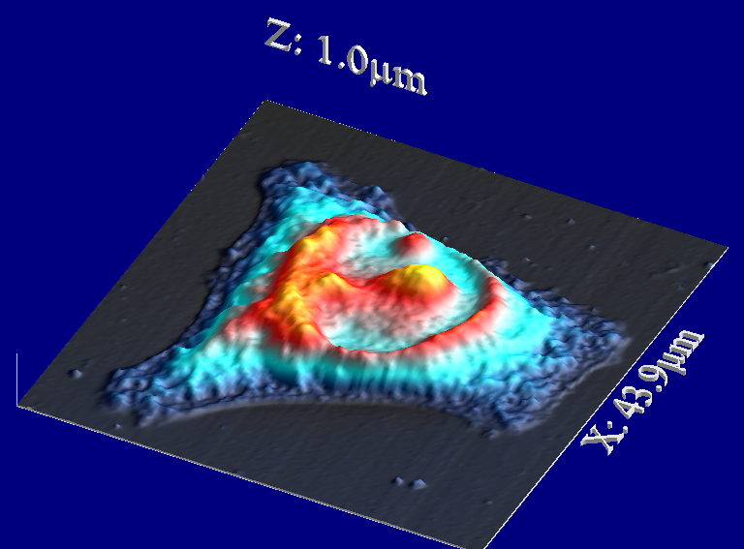
Title: “Sicily cell”
Submitted by:
Author name
Affiliation:
Institute, city, country?
Instrument: AFM XXXX
Description:
… atomic force microscopy image of …

Slide 2
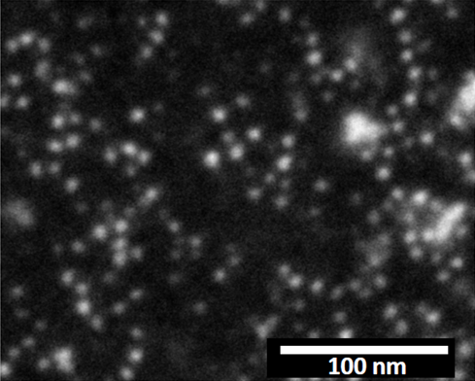
Title: “Cielo stellato”
Submitted by:
Author name
Affiliation:
Institute, city, country?
Instrument: Field emission Scanning electron microscope
Description:
… scanning electron micrograph showing a thin film of ferritn: single ferritin units are visible.

Slide 3
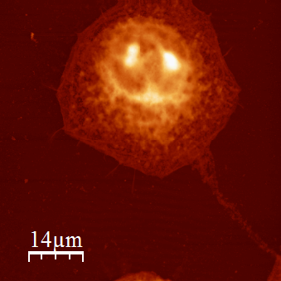
Title: “Cellu-razza”
Submitted by:
Author name
Affiliation:
Institute, city, country?
Instrument: AFM XXXX
Description:
… atomic force microscopy image of …

Slide 4
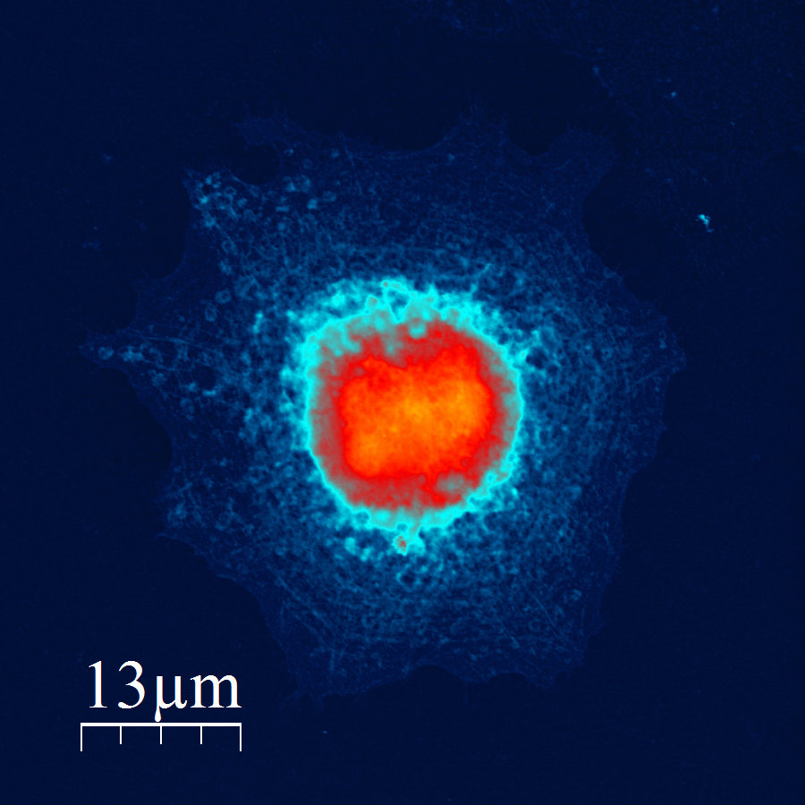
Title: “Occhio di bue”
Submitted by:
Author name
Affiliation:
Institute, city, country?
Instrument: AFM XXXX
Description:
… atomic force microscopy image of …

